Slide 1
Structural Analysis & Design Software

Slide 2
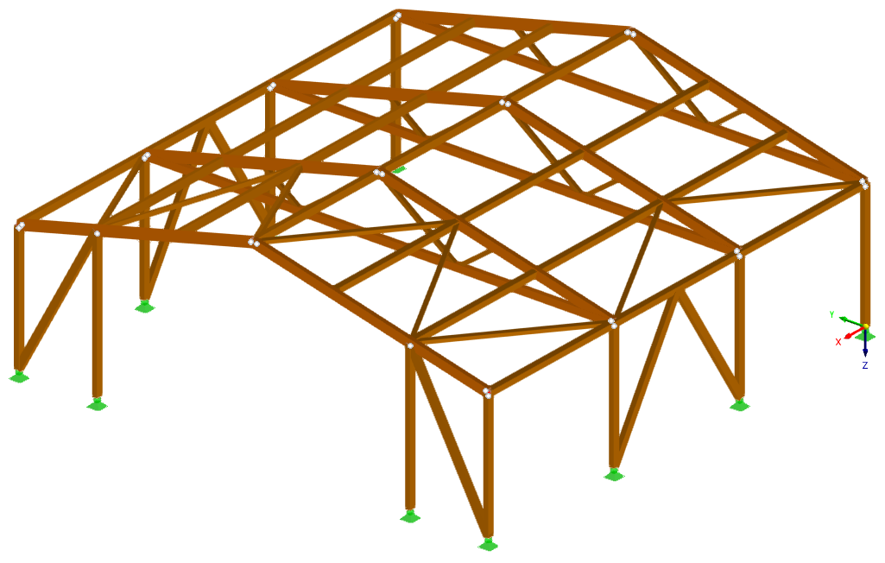
Model and Design Timber Structures in RFEM 6 and RSTAB 9
Dipl.-Ing. (FH) Andreas Hörold
Organizer
Marketing & Public Relations Dlubal Software GmbH
Webinar
Dipl.-Ing. (FH) Bastian Kuhn, M.Sc.
Co-Organizer
Product Engineering & Customer Support Dlubal Software GmbH
Dipl.-Ing. (FH) Gerhard Rehm
Co-Organizer
Product Engineering & Customer Support Dlubal Software GmbH

Slide 3
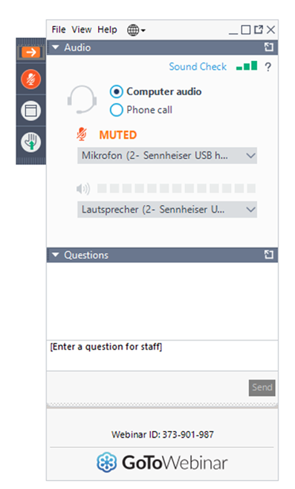
Questions During the Presentation
Show or hide control panel
Adjust audio settings
GoToWebinar Control Panel
Desktop
E-mail: info@dlubal.com
Webinar
Ask questions

Slide 4
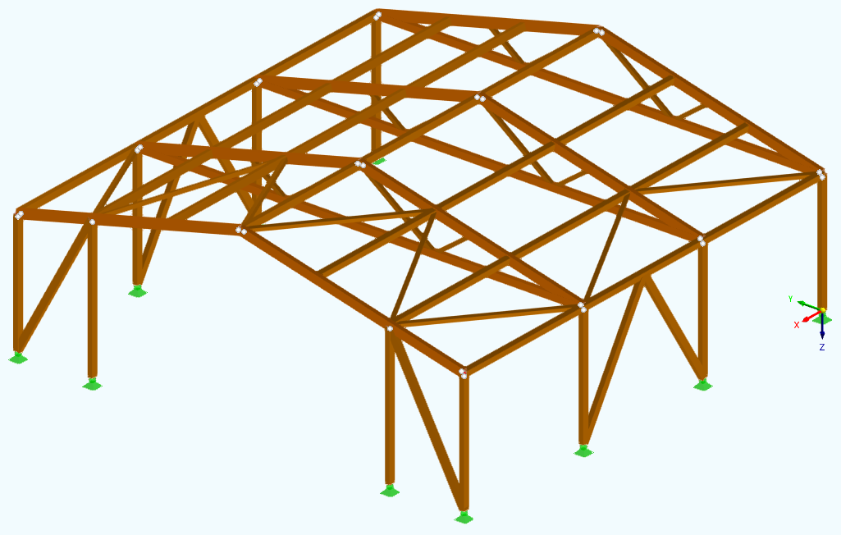
CONTENT
01
Timber structure modelling in RFEM 6
02
Load input, combinatorics
Webinar
03
Timber structure design according to Eurocode 5
04
Documentation in the printout report

Slide 5
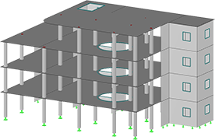
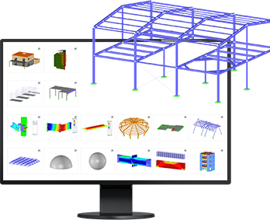
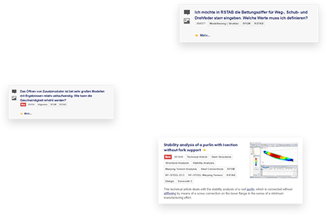
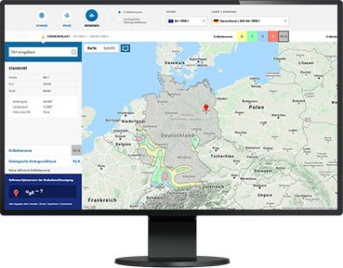
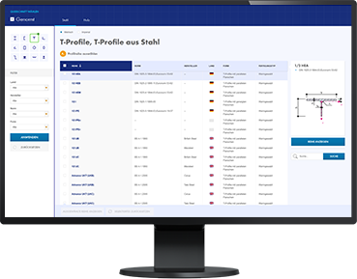
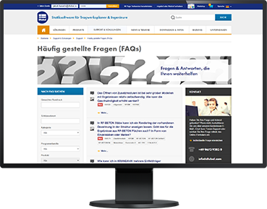
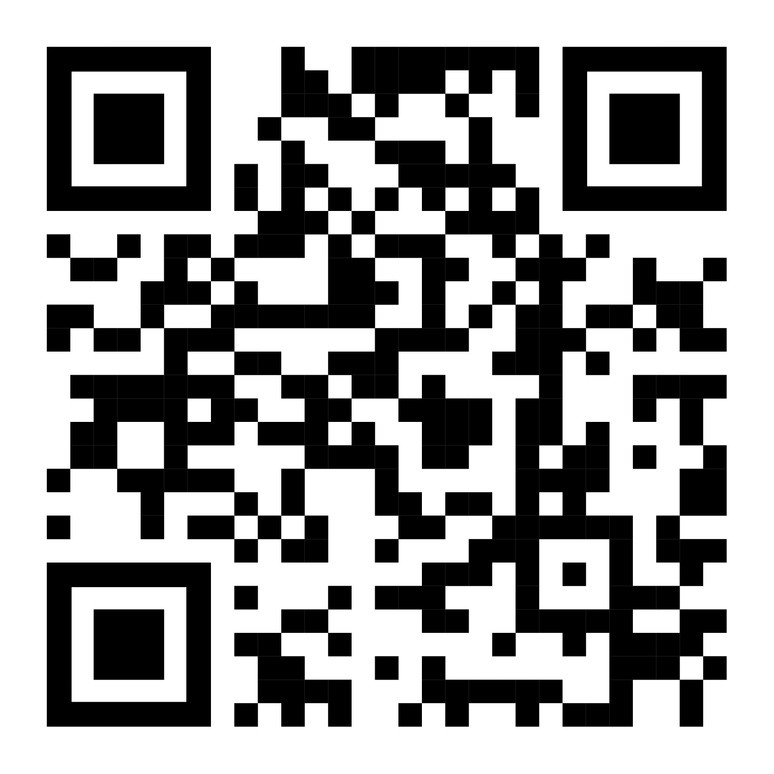
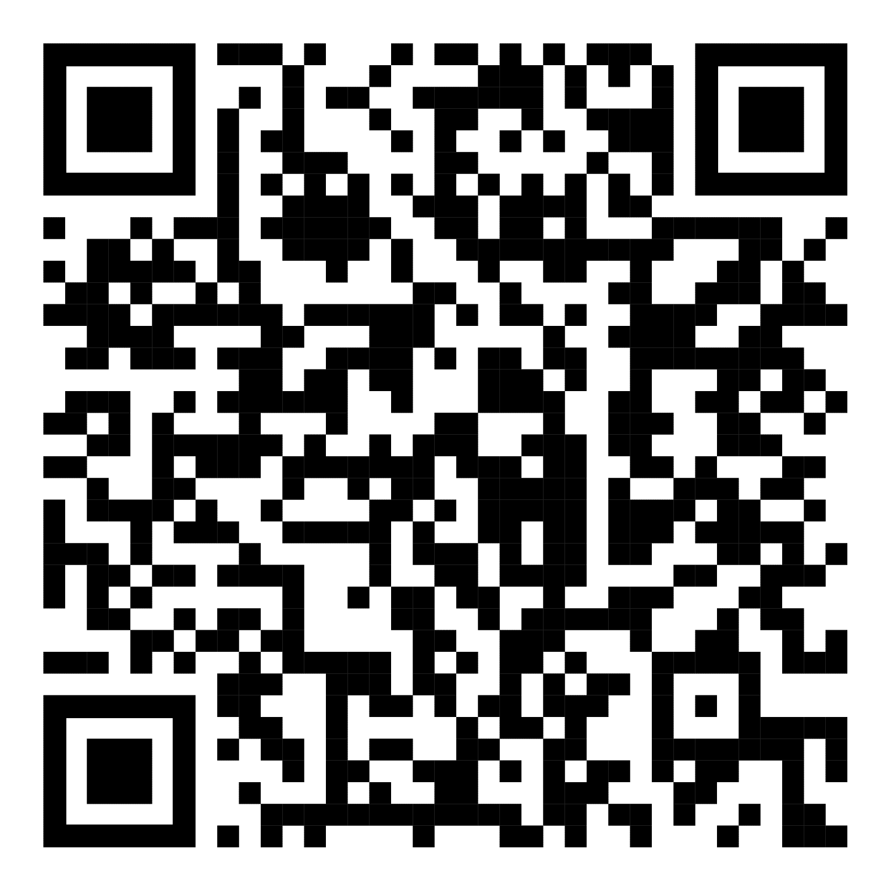
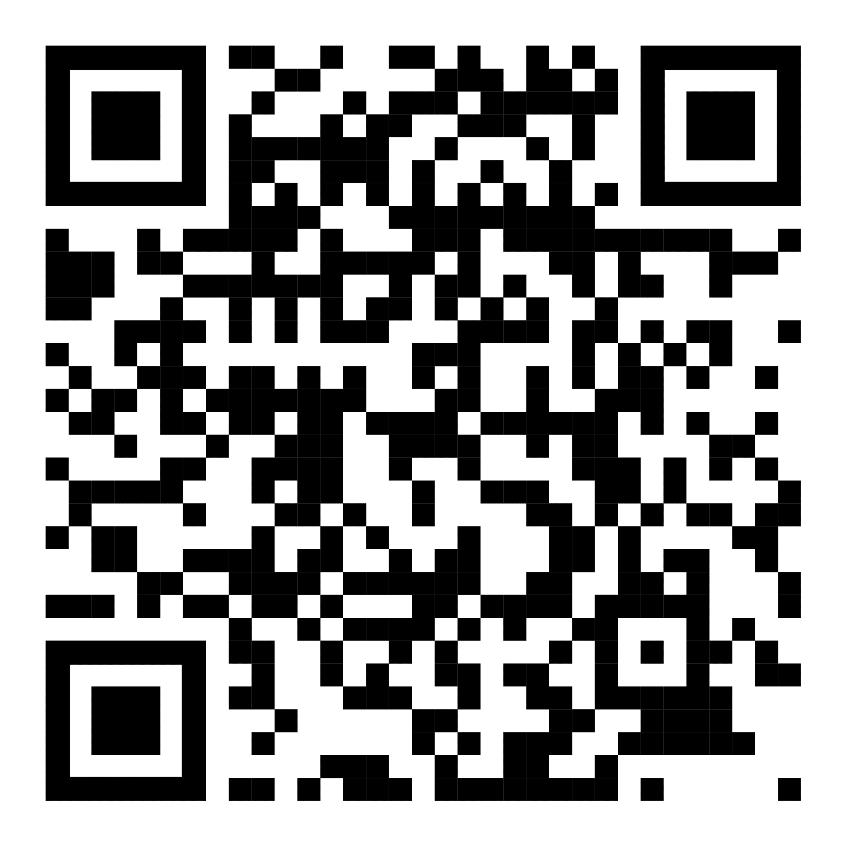
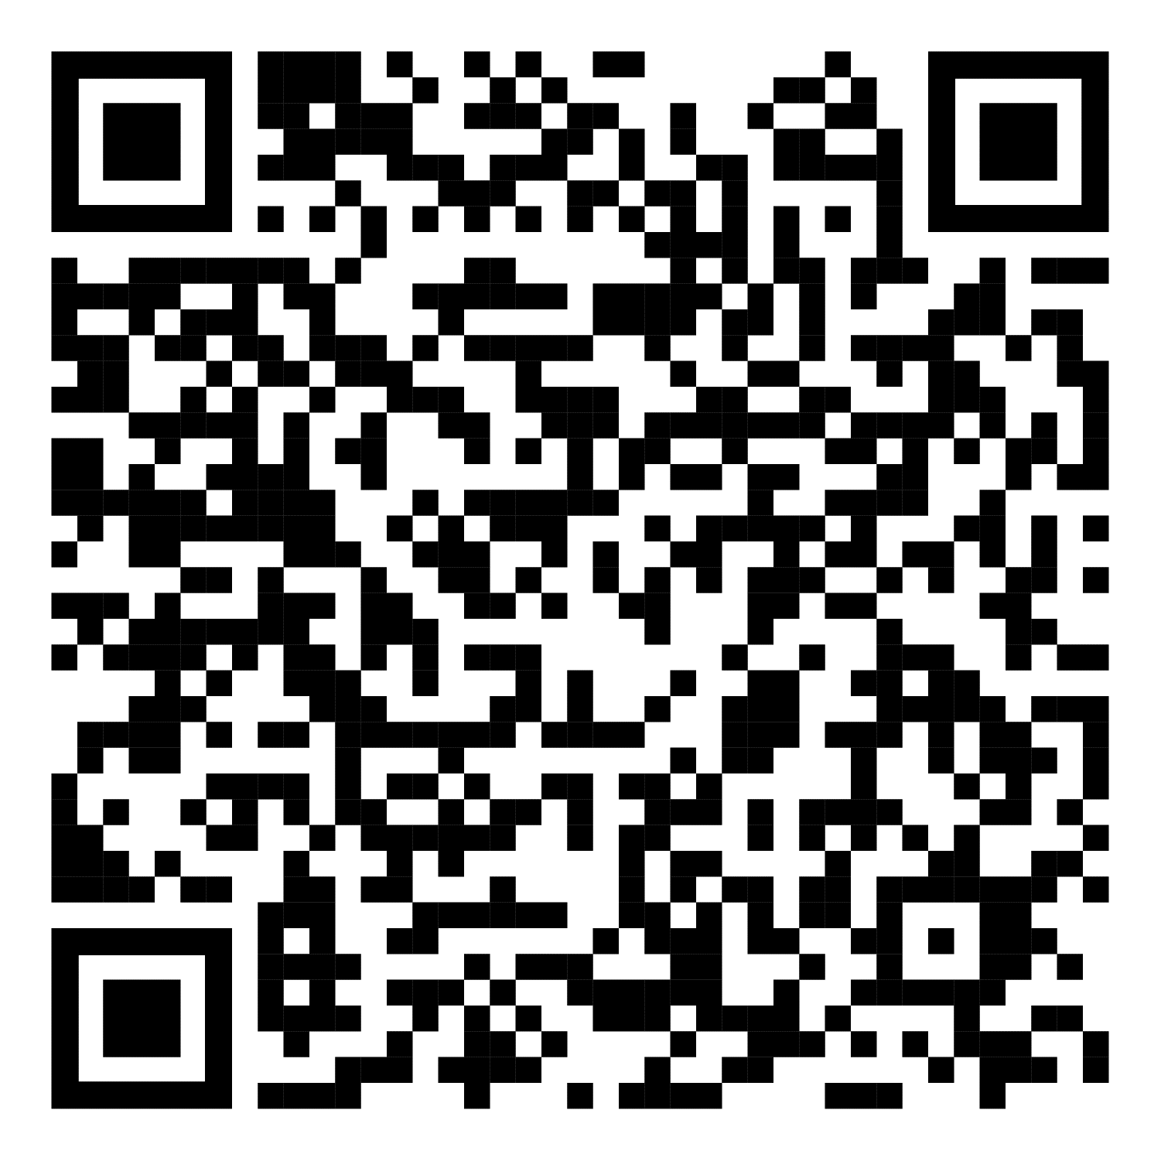
Free Online Services
Dlubal Software
Cross-Section Properties
FAQs & Knowledge Base
Models to Download
Geo-Zone Tool
Dlubal Software provides an online tool with snow, wind and seismic zone maps.
With this free online tool, you can select standardized sections from an extensive section library, define parametrized cross-sections and calculate its cross-section properties.
Access frequently asked questions commonly submitted to our customer support team and view helpful tips and tricks articles to improve your work.
Download numerous example files here that will help you to get started and become familiar with the Dlubal programs.
Webinar

Slide 6
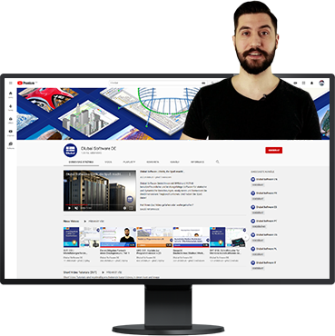
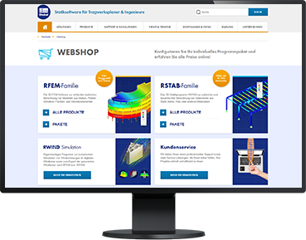
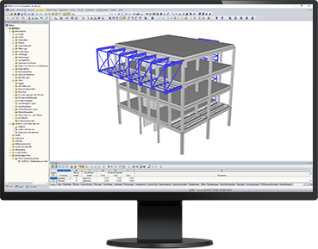
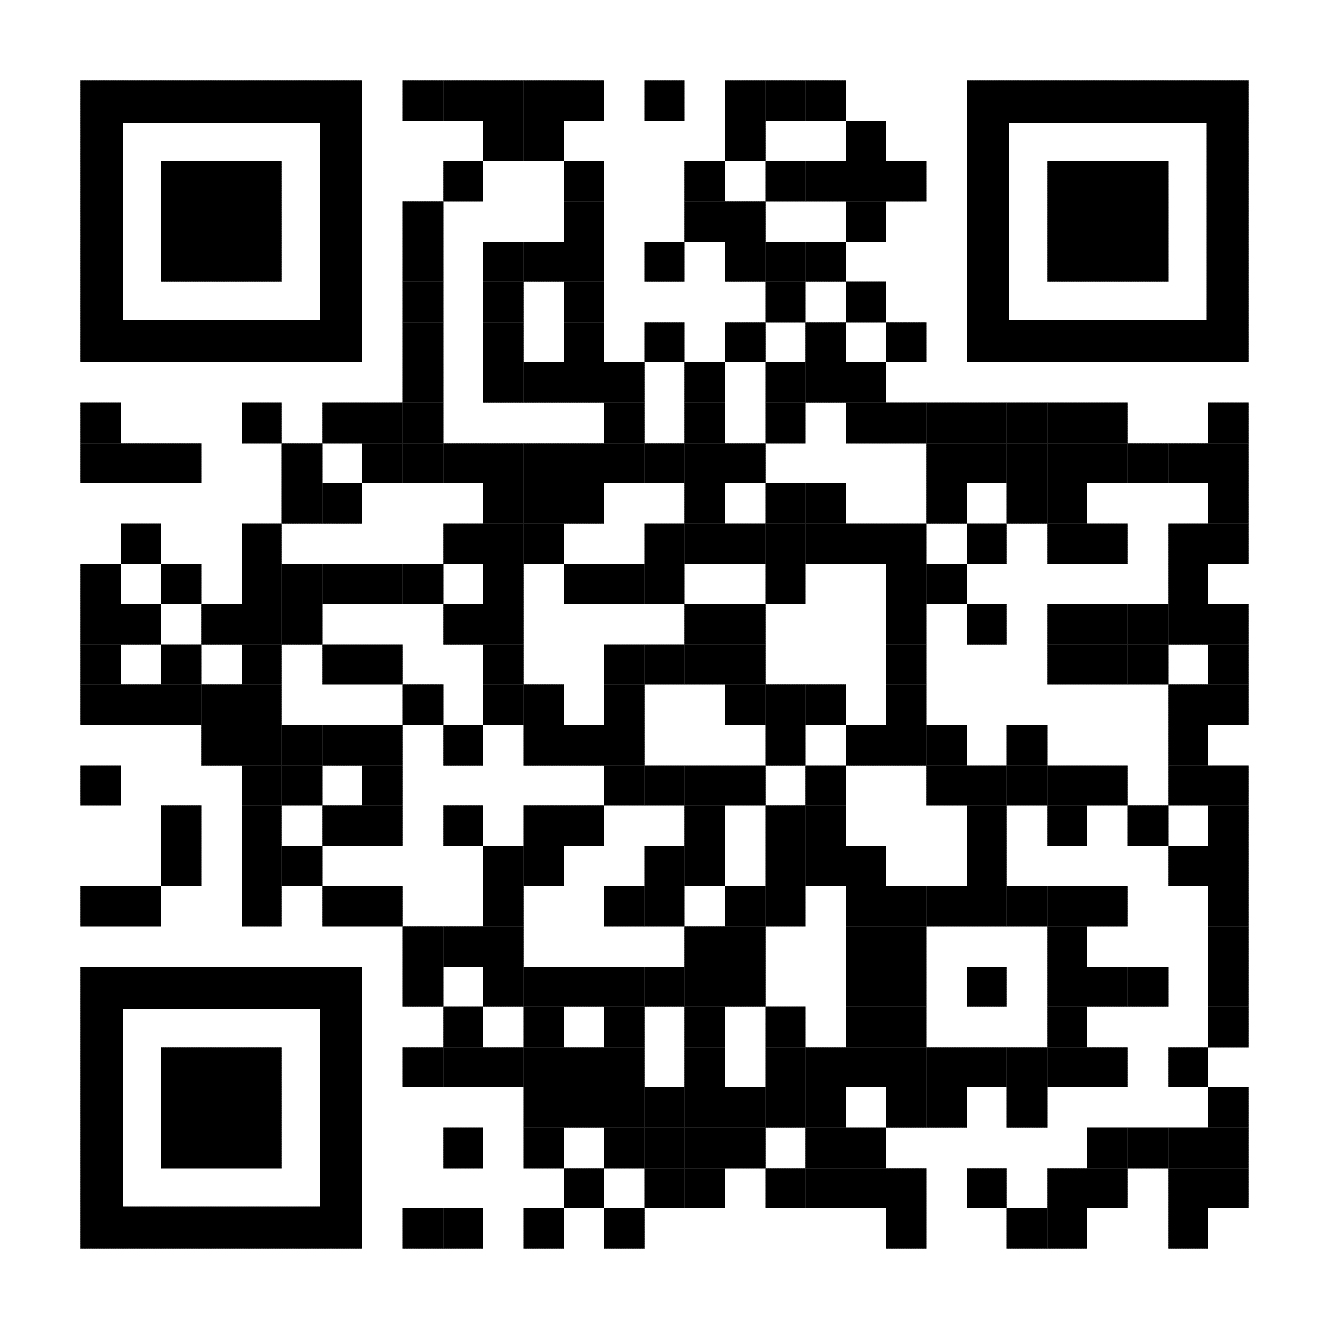
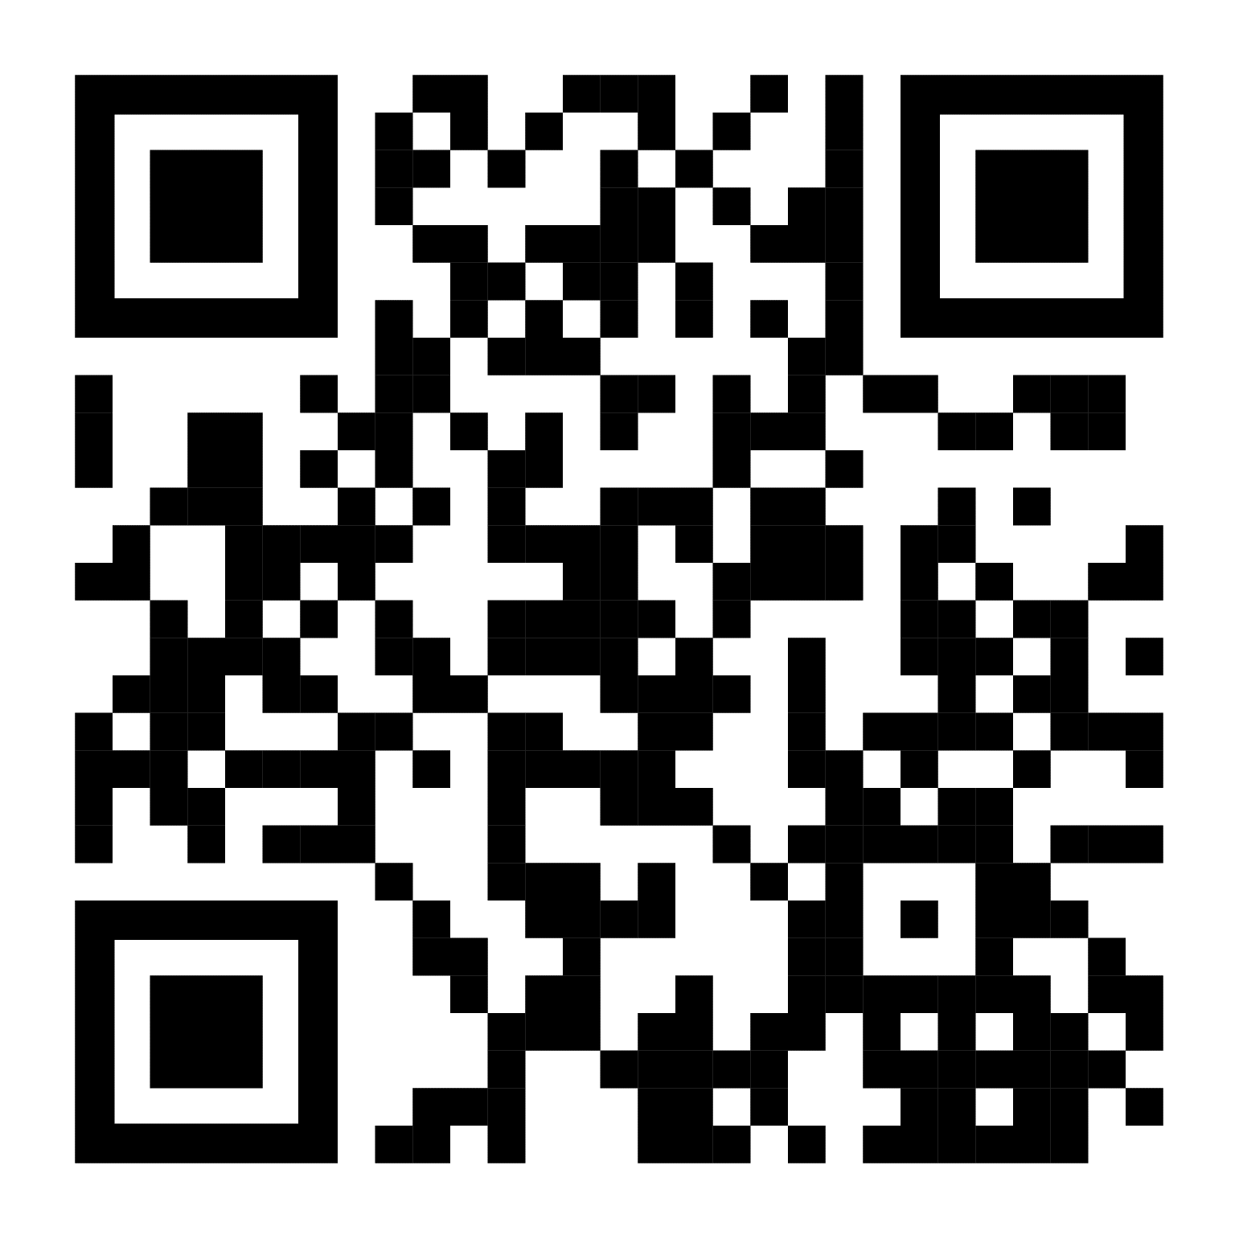
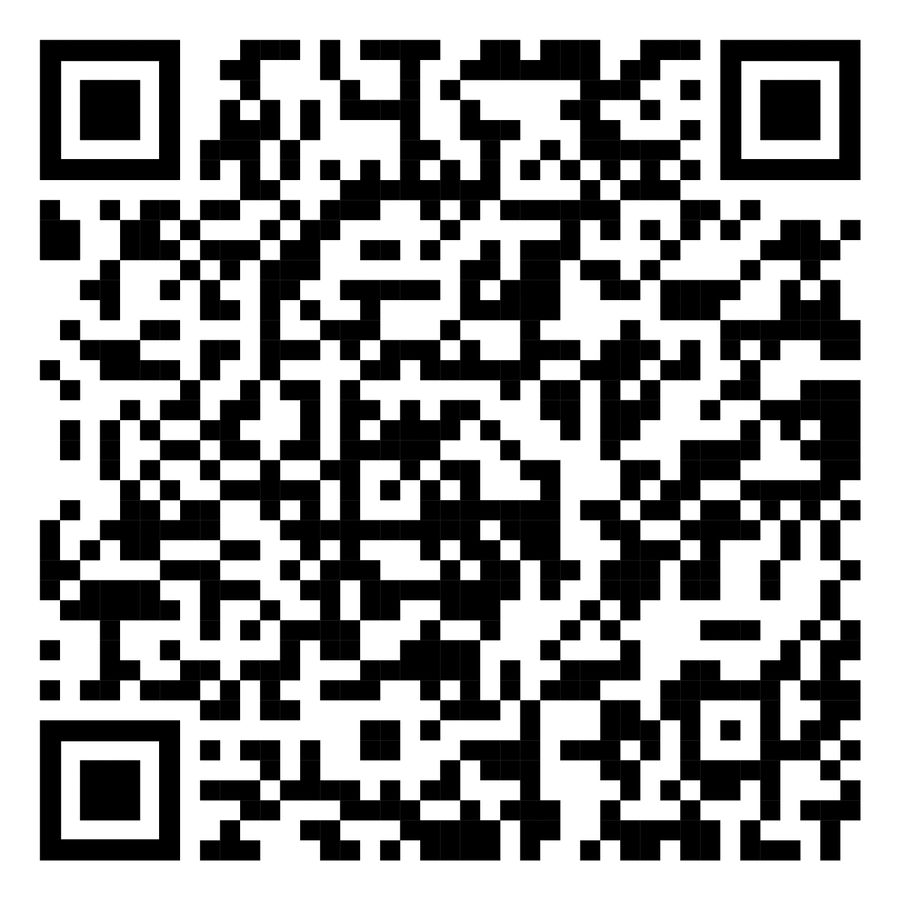
Free Online Services
Dlubal Software
We offer free support via email and chat
Youtube Channel - Webinars, Videos
Webshop with Prices
Trial Licenses
Videos and webinars about the structural engineering software.
Configure your individual program package and get all prices online!
The best way how to learn using our programs is to simply test them for yourself. Download a 90-day free trial version of our structural analysis & design software.
Webinar
90-DAY FREE TRIAL

Slide 7
Get Further Details About Dlubal
Videos and recorded webinars
Newsletters
Events and conferences
Knowledge Base articles
See Dlubal
Software in action in a webinar
Download free trial license
Visit website
www.dlubal.com
Dlubal Software GmbH
Am Zellweg 2,
93464 Tiefenbach, Germany
Phone: +49 9673 9203-0
E-mail: info@dlubal.com

Slide 8
www.dlubal.com

